Slide 1
Violations of well-formed XML
As shown using Architag XRay XML editor.

Slide 2
The seven rules
Every element must have a start tag and an end tag.
A document must have a single, unique root element.
Element and attribute names are case-sensitive.
Elements must be properly nested.
Certain characters must be escaped, or represented by a combination of characters.
Attribute values must be in quotes.
Empty elements have a special form that they must adhere to.

Slide 3
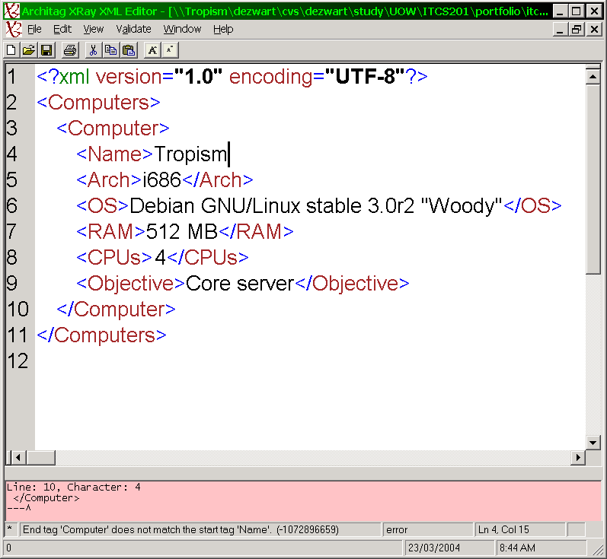
Every element must have a start tag and an end tag.

Slide 4
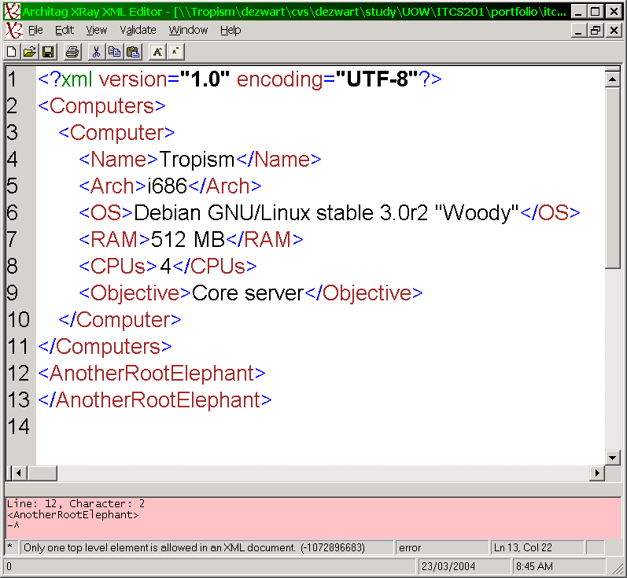
A document must have a single, unique root element.

Slide 5
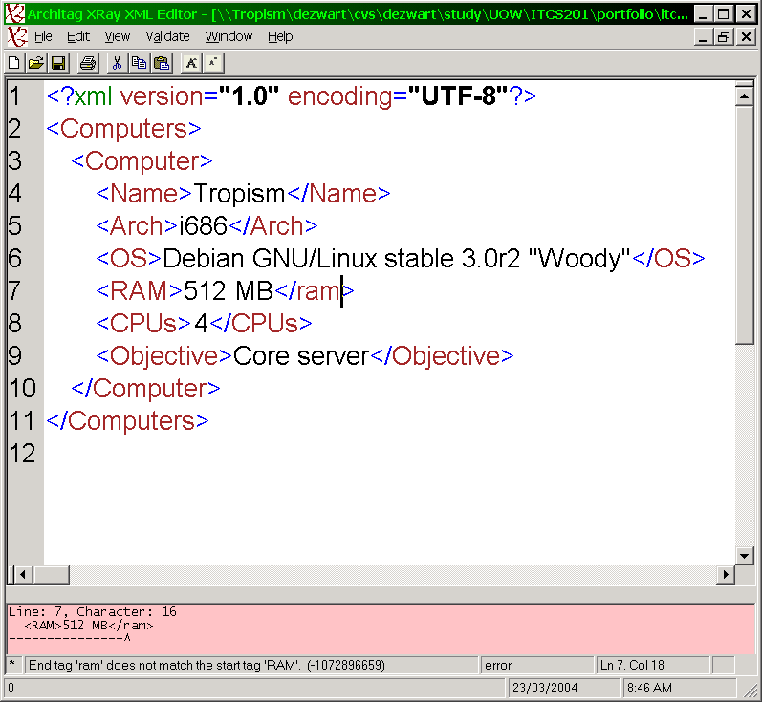
Element and attribute names are case-sensitive.

Slide 6
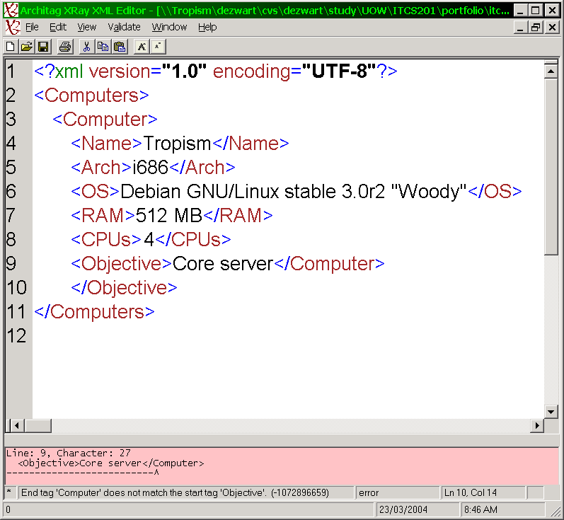
Elements must be properly nested.

Slide 7
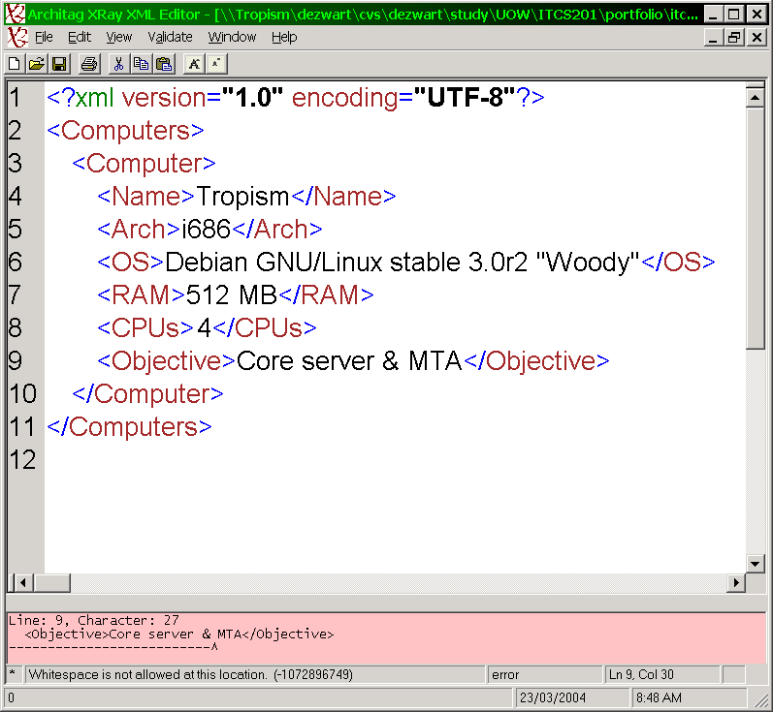
Certain characters must be escaped, or represented by a combination of characters.

Slide 8
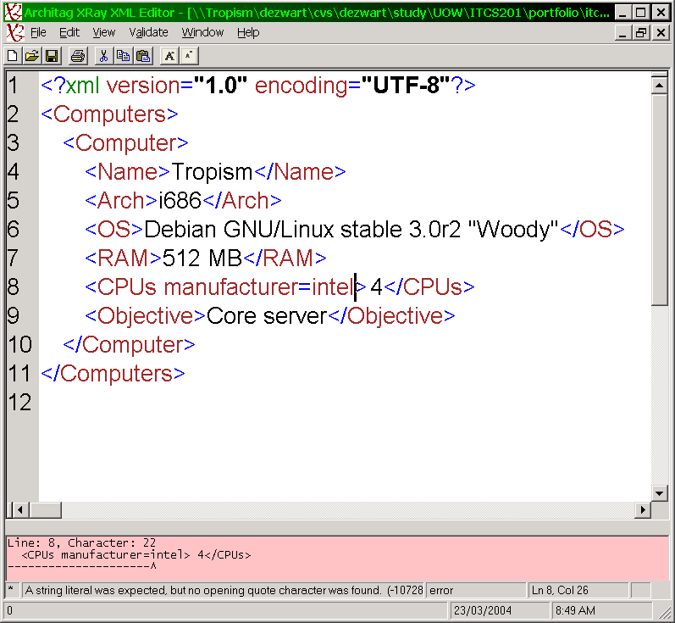
Attribute values must be in quotes.

Slide 9
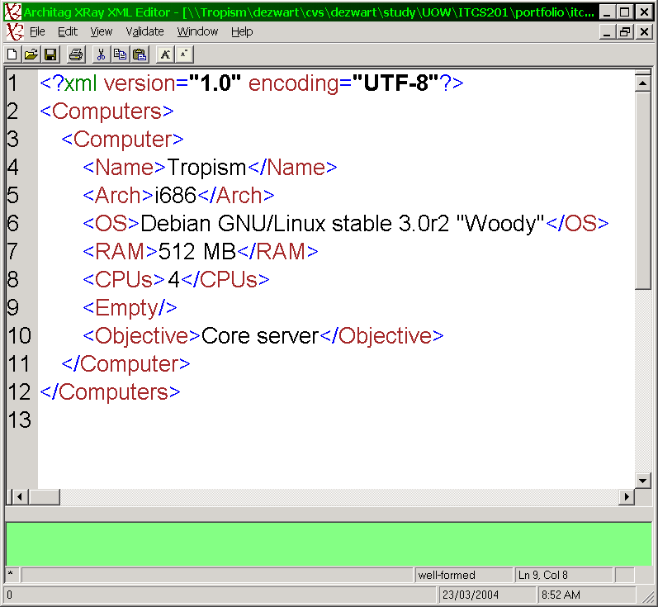
Empty elements have a special form that they must adhere to.

